Slide 1
Park Adventure
Part A and B

Slide 2
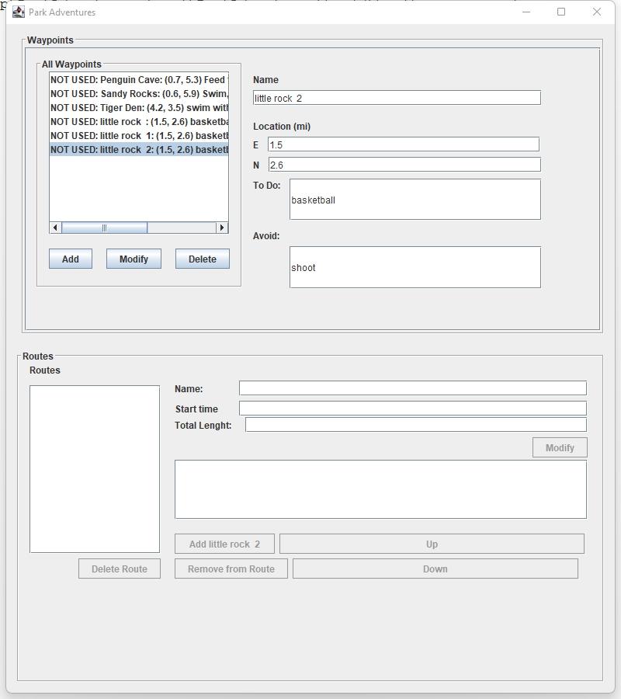
Add and Delete Waypoint:
Have all available waypoints to be listed.
Able to modify additional waypoints.

Slide 3
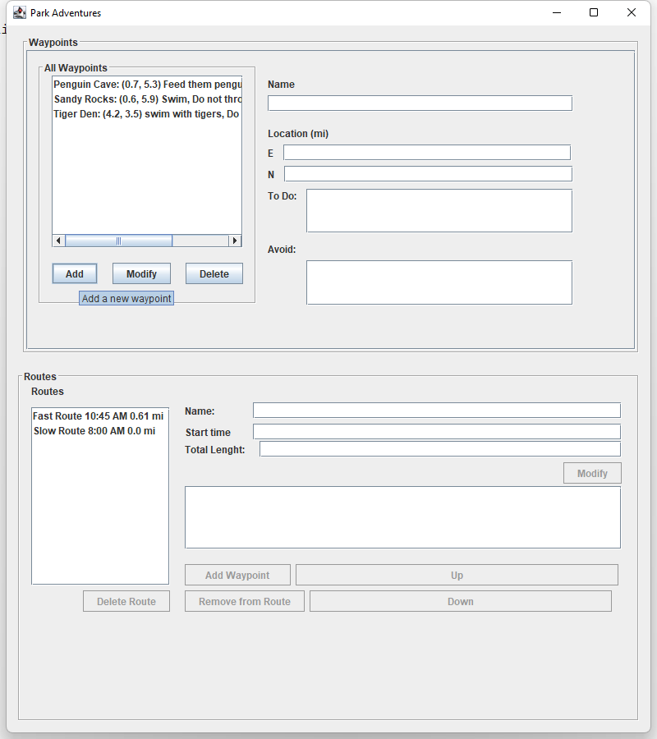
You can just create waypoints with locations, activities, and avoids, when nothing is selected, press “Add” to add to available waypoints.
When new waypoint is created, because its has not been added to routes, it will show up as “NOT USED+ the waypoint.
By selecting available waypoints, you can make changes to it, such as name, location, activities, and avoids.

Slide 4
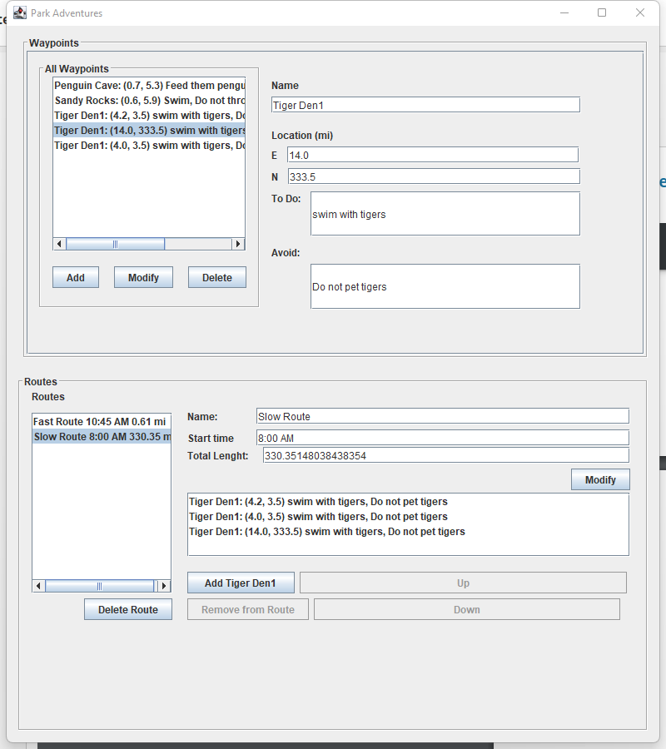
once a waypoint is added to route, it will automatically update the total length of the route.

Slide 5
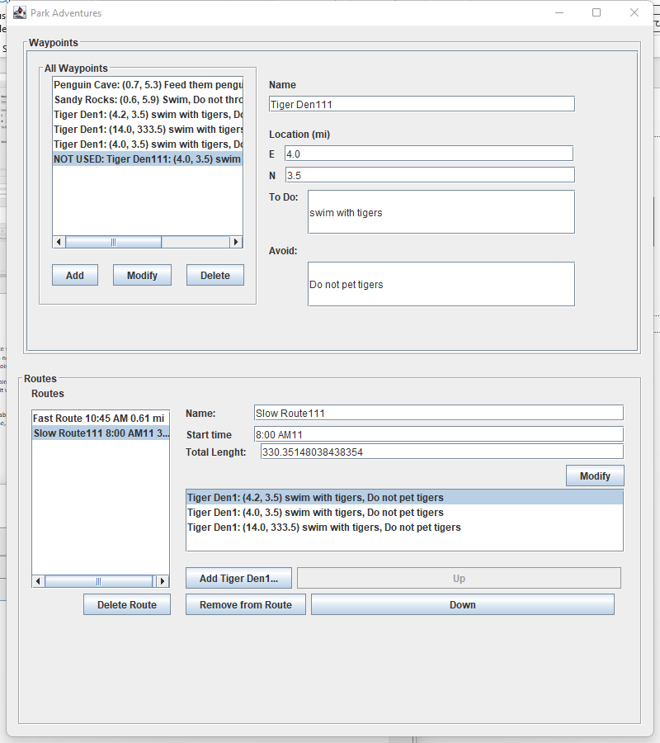
All properties within routes can be modified, such as name, start time.

Slide 6
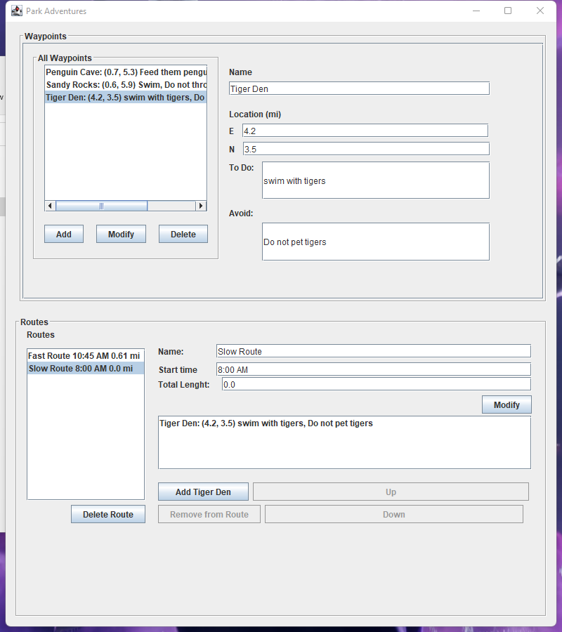
Possible improvements:
Under waypoints, once any waypoint is selected, there isn’t a way to not select anything from the list, which make it very confusing if user were trying to add a new waypoint.
The correct way to create a new or add a new waypoint if something is selected, you have to manually erase the selected waypoint’s properties, and then press add.
One other problem is, the user is not allowed to create waypoints with same names, but you can modify the name to the same.
Total length has too many decimals.

